Slide 1

Team Name: Chinam
Group Members:
Ziyang
Benjamin Loh
Rain
Hoang
Duke
Lam

Slide 2
Scope
Problem Statement
Intended Audience
Our Solution
FindYourFlat
Class Diagram
Use Case Diagram
Application Live Demo

Slide 3
Problem Statement
Flats sourcing has been a problem for many Singaporeans due to the high costs and limited land space. Especially with BTO and SBF flats where information relating to them are only available on HDB.

Slide 4

Intended Audience
Young Married/Engaged Couples
Mature Adults in their 30s/40s looking for their 2nd flat.

Slide 5

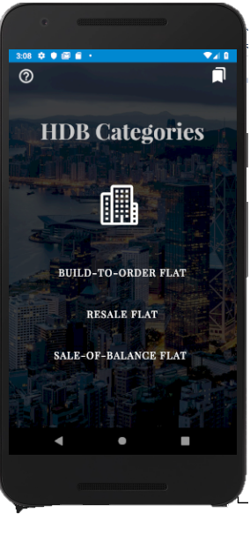
Our Solution: FindYourFlat

Slide 6
FindYourFlat
Google Firebase
Data.gov.sg Resale Flat Prices Data API
Python Data Scraping with beautifulsoup from HDB websites
Google Maps API

Slide 7
System Architecture
Presentation
Log-in UI
Main UI
Map UI
Application Logic
Filter Manager
Client Manager
Flat Manager
Map API Manager
Persistent data
Database
Getsbfflats()
Getupcomingbtoflats()
Getpastbtoflats()
GoogleFireBaseimpl
InternalFileImpl

Slide 8
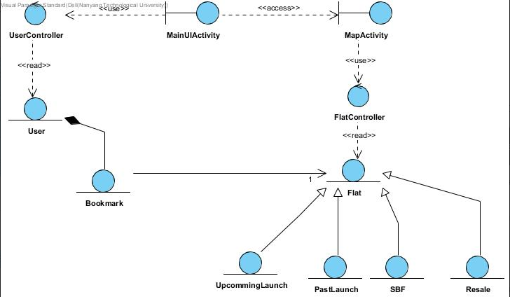
Class Diagram
Notes:
Boundary Classes comprises of Main UI Activity and Map Activity
Control Classes are User Controller and Flat Controller
Upcoming Entity Classes are part of

Slide 9





Login
FindYourFlat
Registration
<<Extend>>
Google Login
View BTO flat information
<<Extend>>
Google Firebase
Bookmark a Flat
View Sales of Balance Flats
<<Extend>>
<<Include>>
Filter Flats
<<Include>>
<<Extend>>
View Resale Flats on Map
Google Maps API
User
View Bookmarks
Remove Bookmarks
<<Extend>>
Data.gov.sg API
Notes:
Must elaborate that data comes from data.gov.sg and google firebase
Must elaborate that Registration will

Slide 10


Live Demo

